Slide 1
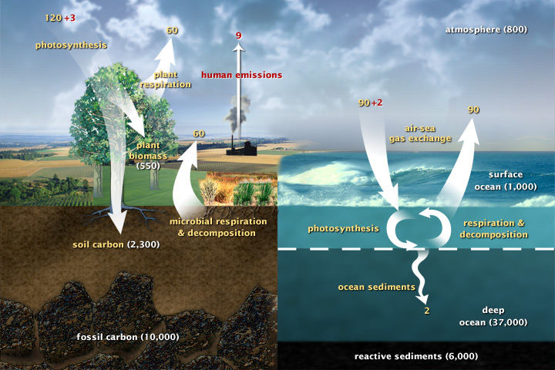
Carbon fluxes in Earth’s climate system
It’s good to know about how carbon flows through the climate system.
Informing this discussion:
Keenan & Williams, 2018
(377 ppm)

Slide 2
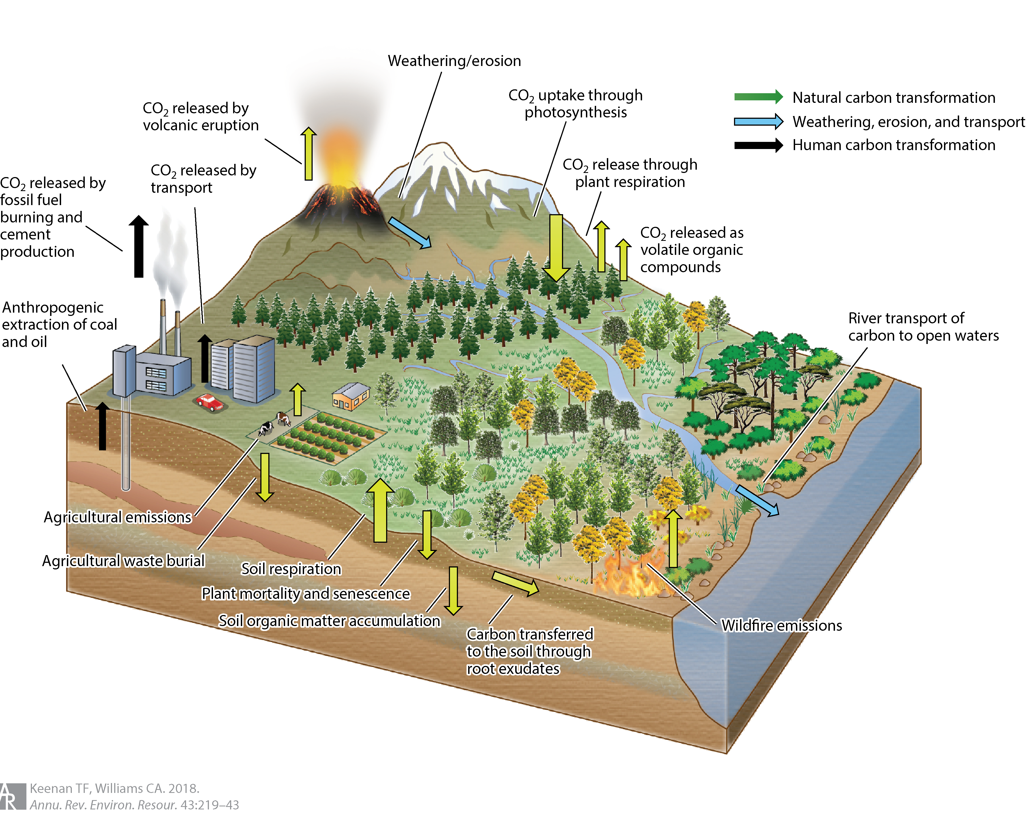
Keenan & Williams, 2018, the big picture of carbon exchange
Figure 1 The primary flows and exchanges that constitute the terrestrial carbon cycle, including uptake through photosynthesis, release to the atmosphere through both anthropogenic (fossil fuel emissions, biomass burning, land use) and natural emissions (autotrophic and heterotrophic respiration, wildfires, volcanic eruptions), and weathering, erosion, and transport. Figure modified with permission from Diana Swantek, Lawrence Berkeley National Lab.

Slide 3
Keenan & Williams, 2018, the big picture of carbon exchange
“Ecosystems are thus in a perpetual cycle of being knocked away from equilibrium by disturbance, while at the same time the natural equilibrium point is changing due to environmental change. Changes in the disturbance regime, and persistent environmental change can also completely change the playing field by altering ecosystem structure sufficiently to create a regime shift to a new stable equilibrium state.”
Figure 1 The primary flows and exchanges that constitute the terrestrial carbon cycle, including uptake through photosynthesis, release to the atmosphere through both anthropogenic (fossil fuel emissions, biomass burning, land use) and natural emissions (autotrophic and heterotrophic respiration, wildfires, volcanic eruptions), and weathering, erosion, and transport. Figure modified with permission from Diana Swantek, Lawrence Berkeley National Lab.

Slide 4
What also stands out is the idea that these processes are connected (“feedbacks”)
“Ecosystems are thus in a perpetual cycle of being knocked away from equilibrium by disturbance, while at the same time the natural equilibrium point is changing due to environmental change. Changes in the disturbance regime, and persistent environmental change can also completely change the playing field by altering ecosystem structure sufficiently to create a regime shift to a new stable equilibrium state.”
Figure 1 The primary flows and exchanges that constitute the terrestrial carbon cycle, including uptake through photosynthesis, release to the atmosphere through both anthropogenic (fossil fuel emissions, biomass burning, land use) and natural emissions (autotrophic and heterotrophic respiration, wildfires, volcanic eruptions), and weathering, erosion, and transport. Figure modified with permission from Diana Swantek, Lawrence Berkeley National Lab.

Slide 5
What also stands out is the idea that these processes are connected (“feedbacks”)
“Ecosystems are thus in a perpetual cycle of being knocked away from equilibrium by disturbance, while at the same time the natural equilibrium point is changing due to environmental change. Changes in the disturbance regime, and persistent environmental change can also completely change the playing field by altering ecosystem structure sufficiently to create a regime shift to a new stable equilibrium state.”
“Ecosystems exist in a state of dynamic disequilibrium”
Figure 1 The primary flows and exchanges that constitute the terrestrial carbon cycle, including uptake through photosynthesis, release to the atmosphere through both anthropogenic (fossil fuel emissions, biomass burning, land use) and natural emissions (autotrophic and heterotrophic respiration, wildfires, volcanic eruptions), and weathering, erosion, and transport. Figure modified with permission from Diana Swantek, Lawrence Berkeley National Lab.

Slide 6
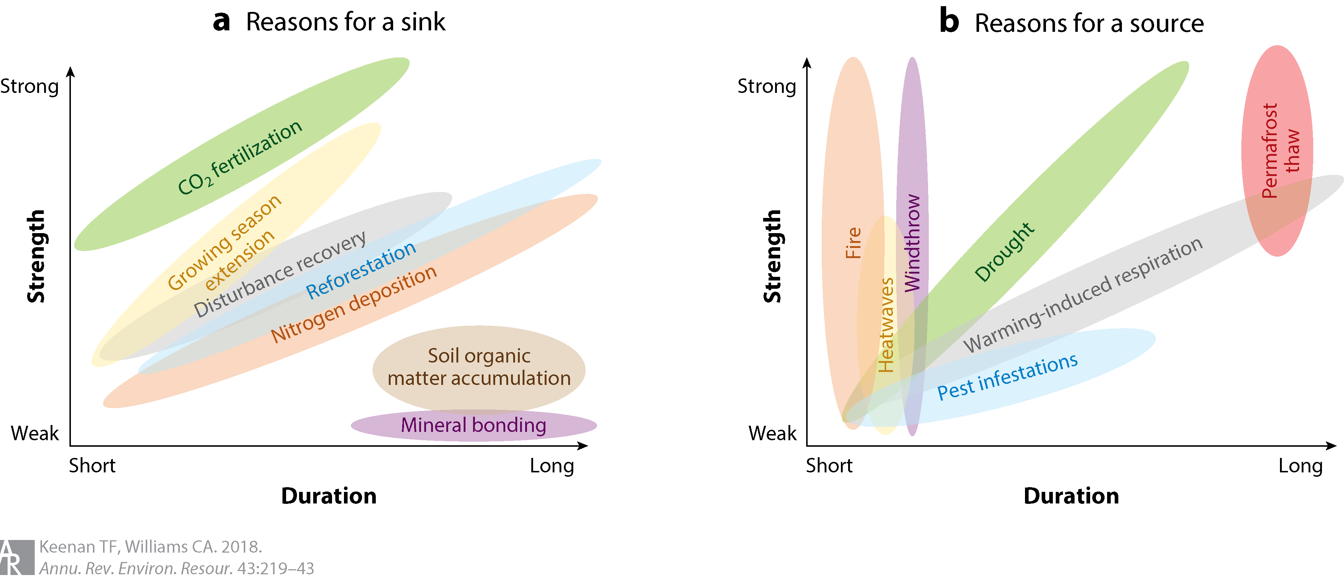
Strength and duration of carbon exchange processes
Figure 2 A schematic of the multiple influences responsible for an ecosystem's (a) sink or (b) source magnitude, separated by their strength and duration. Processes such as CO2 fertilization, growing season extension, and recovery from disturbance have been identified as causes of the current global sink, while drought, warming-induced respiration, and disturbances contribute to sink reductions.

Slide 7
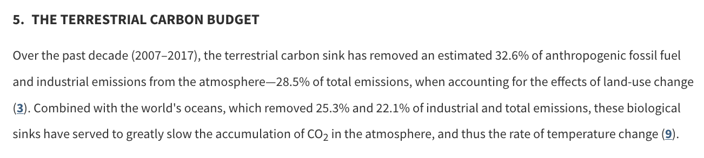
Strength and duration of carbon exchange processes
Figure 2 A schematic of the multiple influences responsible for an ecosystem's (a) sink or (b) source magnitude, separated by their strength and duration. Processes such as CO2 fertilization, growing season extension, and recovery from disturbance have been identified as causes of the current global sink, while drought, warming-induced respiration, and disturbances contribute to sink reductions.

Slide 8
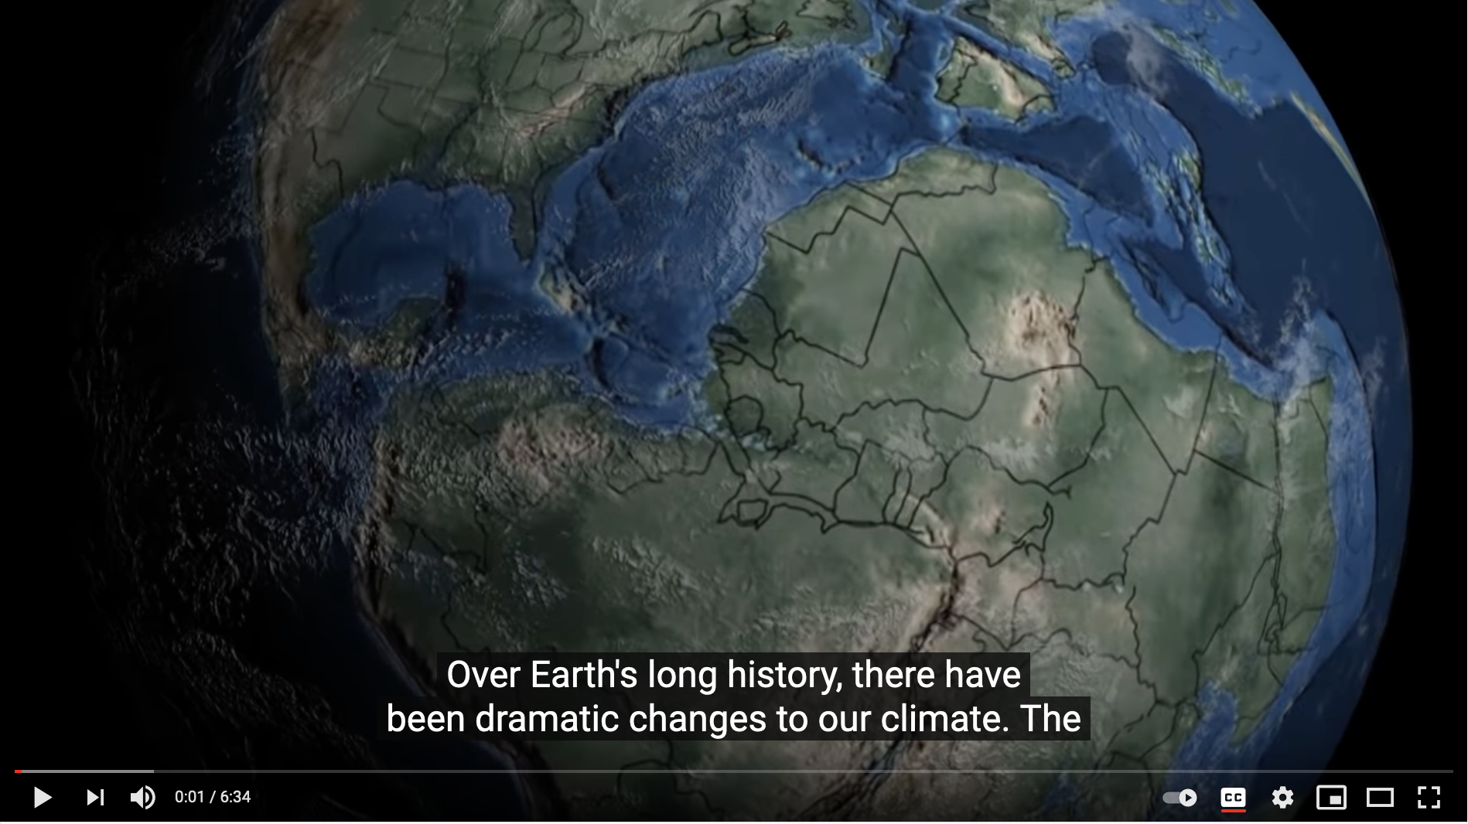
Considering an even longer timescale: Milankovich and the 100,000 year glacial / interglacial pattern
Merrill video on Milankovich

Slide 9
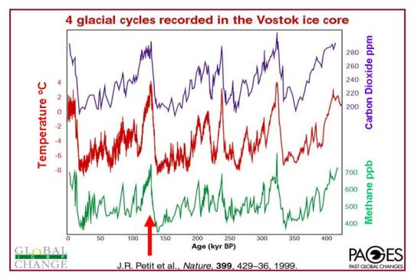
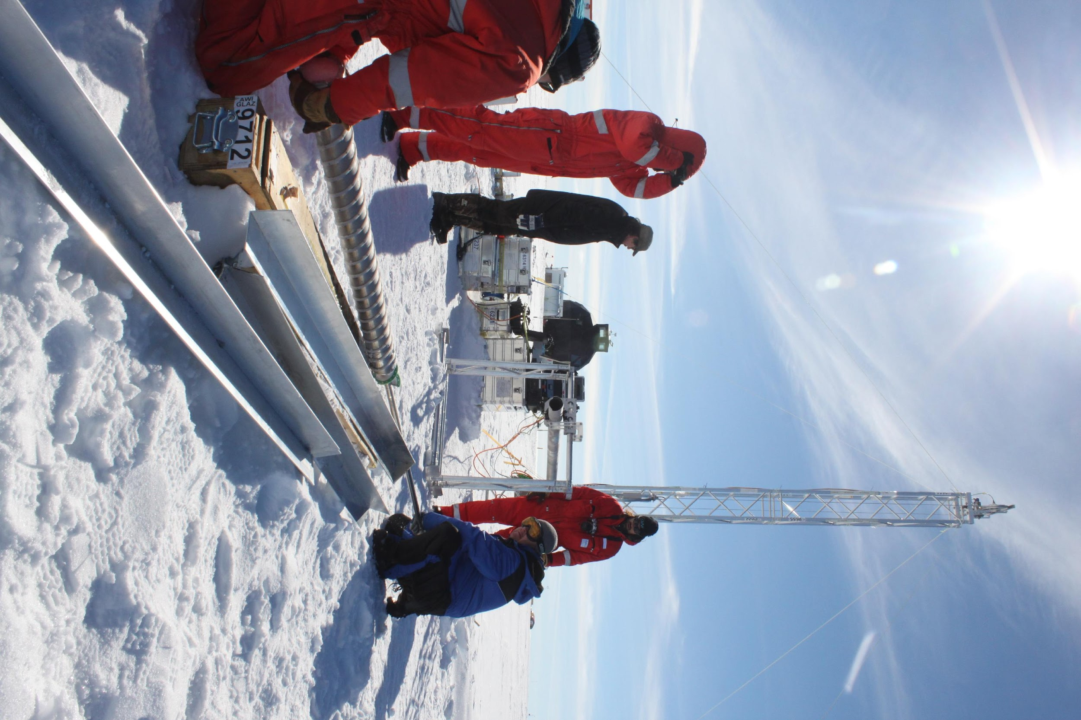
Evidence for CO₂ and CH₄ climate feedbacks over that time period: the Pleistocene “experiment”
Present <------- 400,000 years ago

Slide 10
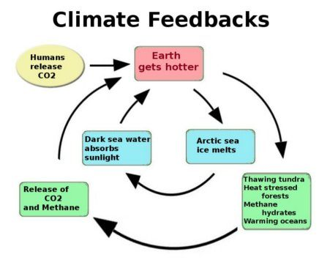
Conclusion: CO₂ and CH₄ (and ice/albedo feedback) act like climate power steering
Present <------- 400,000 years ago
Let Earth wobble
Warmer or
colder
The timing is driven by Earth’s wobbling (“Milankovič in the driver’s seat”), but CO₂ and CH₄ behaved in a way that amplified heating/cooling (ice/albedo is also an amplifier).

Slide 11
Conclusion: CO₂ and CH₄ (and ice/albedo feedback) act like climate power steering
Present <------- 400,000 years ago
Let Earth wobble
Warmer or
colder
Which raises the question: How strong were those feedback mechanisms?

Slide 12
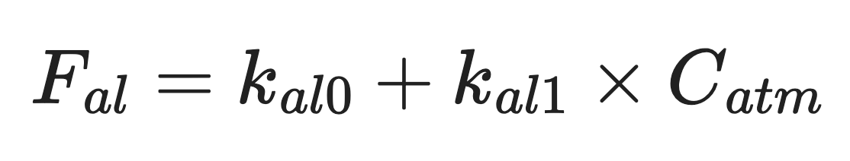
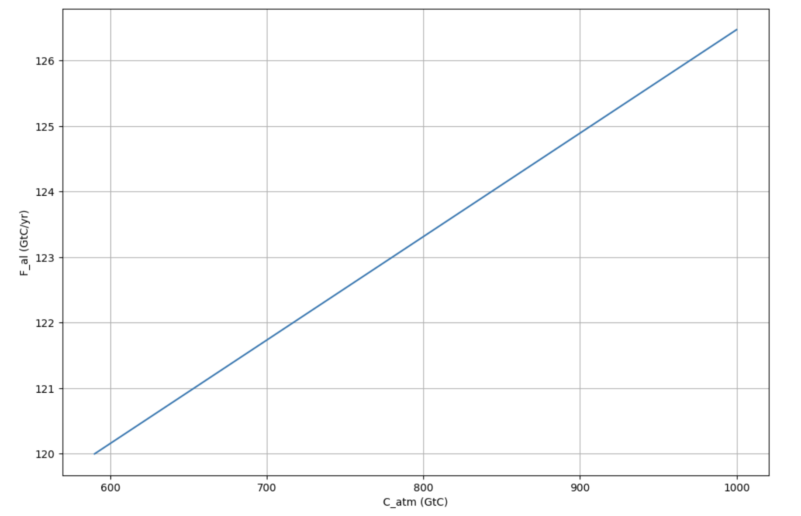



How we’ll be doing this in Python: make $F_{al}$ proportional to how much CO2 there is in the air
In 2026 ($910 GtC$)
In 2003 ($800 GtC$)
pre-industrial atmospheric $CO_{2}$ ($590 GtC$)

Slide 13
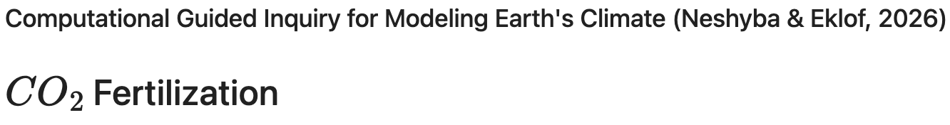
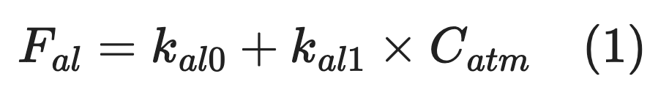
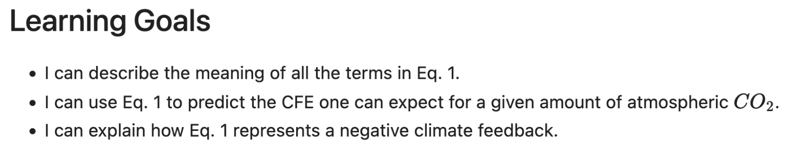
OK, let’s get started
Notes:
Predict the temperature if CO2 continues to rise. If we reduce CO2 emissions to zero.

